Slide 1
BOOTSTRAP FLEXBOX
RESPONSIVE WEBSITE

Slide 2
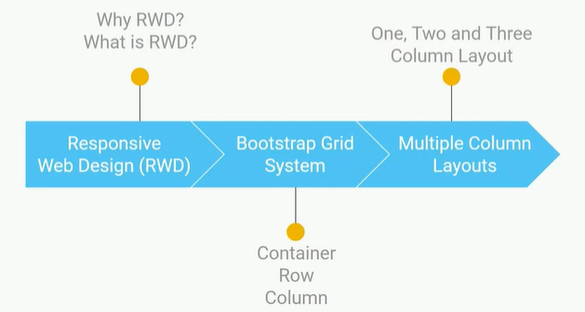

Slide 3
BOOTSTRAP
Collection of reusable code snippets

Slide 4
BOOTSTRAP GRID SYSTEM
We use BGS to design responsive website
Bootstrap lo unna grid system ni use chesi responsive layouts ni create chestham
BGS uses 12 column system for layouting. We can create 12 columns across the page
We can specify how many no.of columns to be occupied by content within range of 1-12

Slide 5
BGS used to create layout
BGS system lo oka container untadi, ah container lopala row untadi,ah row lopala column anedi untadi
The purpose of container is to hold rows and columns
The purpose of row is to wrap all columns
The purpose of column is to place all content

Slide 6

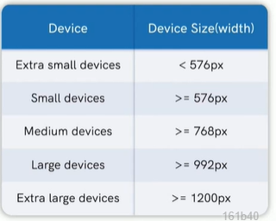
BOOTSTRAP PROVIDES 5 RESPONSIVE TIERS called as resonsive breakpoints in Bootstrap

Slide 7
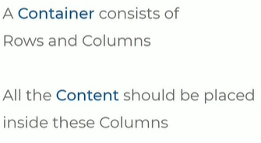
BOOTSTRAP GRID SYSTEM
BOOTSTRAP GRID SYSTEM contains 3 things
Contaier
Rows
Columns

Slide 8
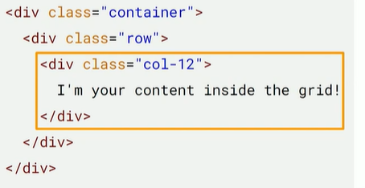
CODE

Slide 9
Oka container create chesam after keeping boot.S in head scetion
Oka row create chesi danilo oka column and specified with number 12
12 columns space ni occupy chesthundi
6 pedithe 6 columns spac eni occupy cheyi ani ardam

Slide 10
Single multiple column layout

Slide 11
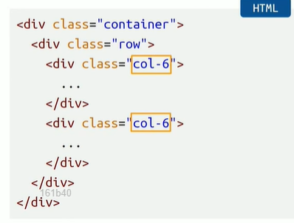
TWO COLUMN LAYOUT
Enni columns kavali ante anni columns thiskovachu ekkada two column layout lo 6 and 6 thiskonnuma

Slide 12
3 COLUMN LAYOUT
Col lo 4
Ey number ayina pettukovachu as our wish

Slide 13
COLUMN WRAPPING
12 colum
6+6+8> 8 next column
6+6 = 12
6+6+10>10 next colum

Slide 14
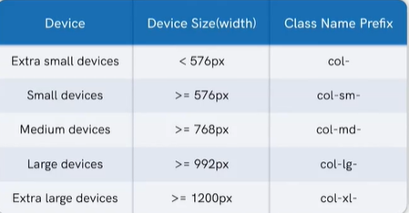
class name prefixes for responsive break points

Slide 15
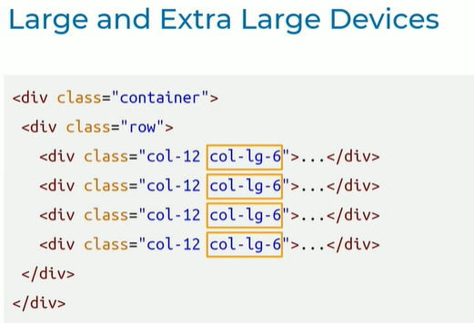
Col-12 extra small devices, small devices , medium
Large devices,extra large lo -6 colum space
If no lg col-12 applicable small,medium,large, extra large

Slide 16
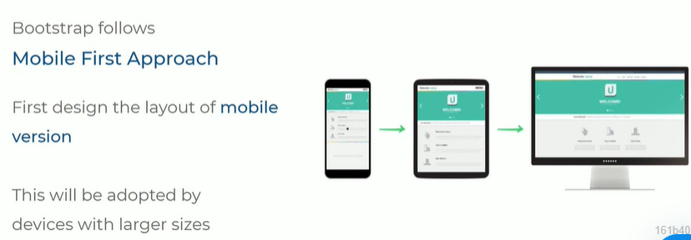

Slide 17
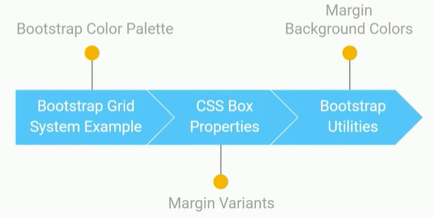
Build BS color palette
Margin variants in CSS
Using margins & bg-colors

Slide 18
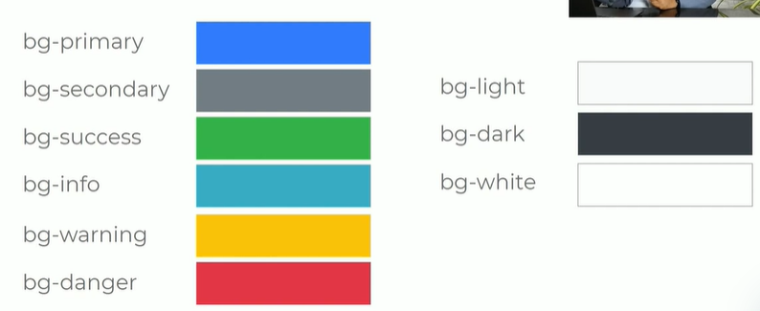
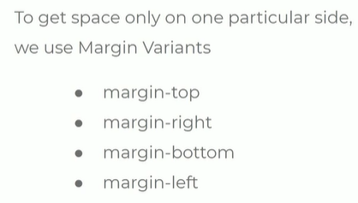
background color utilities and class names
Small-medium-large-extra large

Slide 19
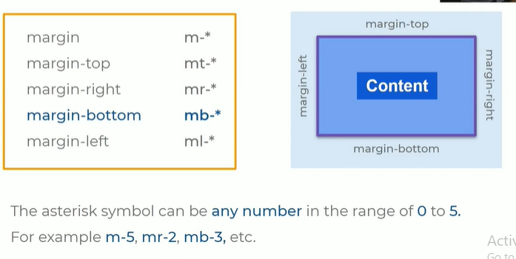
Margin with class prefixes

Slide 20
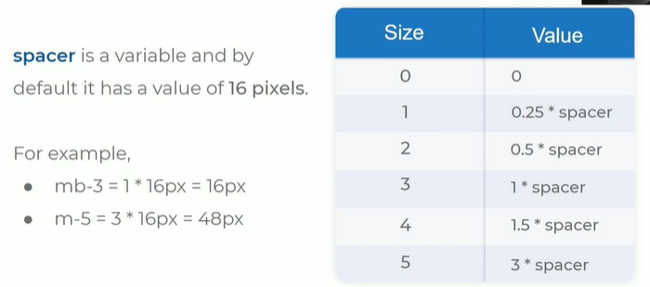
SPACER VARIABLE mb= 3 margin bottom

Slide 21
Mb = 3 ante margin bottom space 16 pixles vachinnatu
Com 12 small device 1 col space
Col-md-6 for medium devices with 6 column spacing
Col-lg-4 for large devices with 4 column spacing
Col-xl-3 for Extra large devices with 3 col space

Slide 22
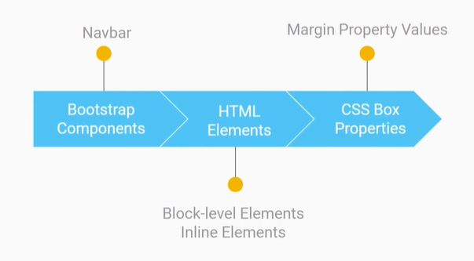
BOOTSTRAP NAVBAR

Slide 23
Navbar image
Height
Width
padding

Slide 24
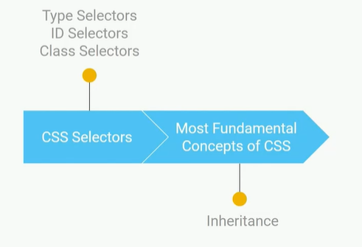
CSS BUILDING BLOCKS
CSS SELECTORS & INHERITANCE
CSS SPECIFICITY & CASCADE

Slide 25
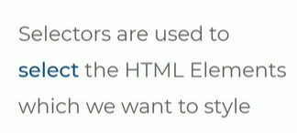
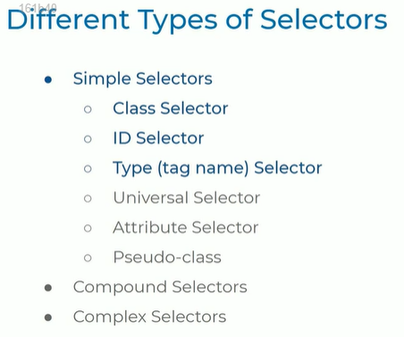
NOW:
CLASS SELECTOR
ID SELECTOR
TYPE (TAG NAME) SELECTOR
Styling done with attribute class,id,tag with dot,hash and tag as values

Slide 26

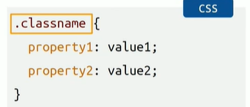
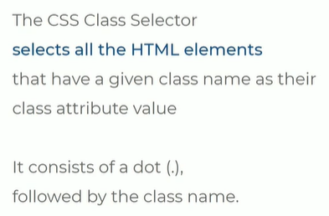

Slide 27
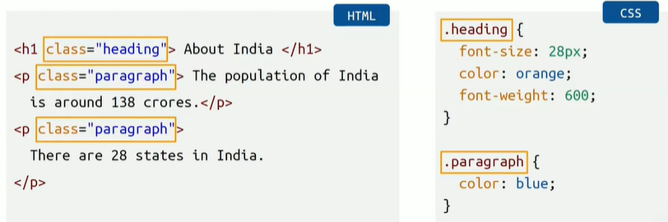
EXAMPLE dot notation

Slide 28

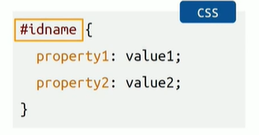
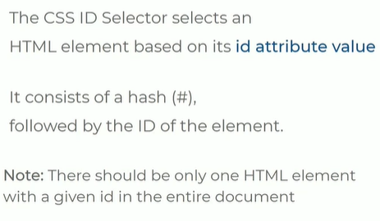

Slide 29
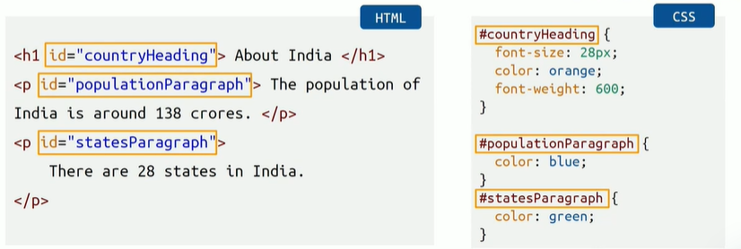
Exmaple # notation

Slide 30

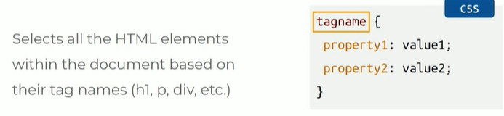
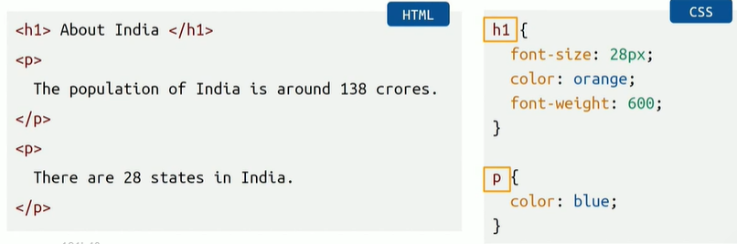
Using direct name

Slide 31
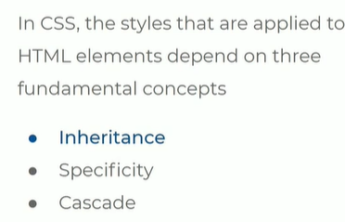

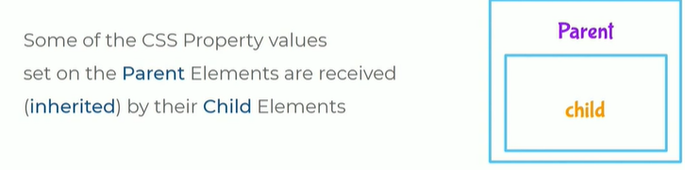
FUNDAMENTAL CONCEPTS IN CSS
Parent ki pettina properties child ki apply ayithe inheritance concept antam

Slide 32
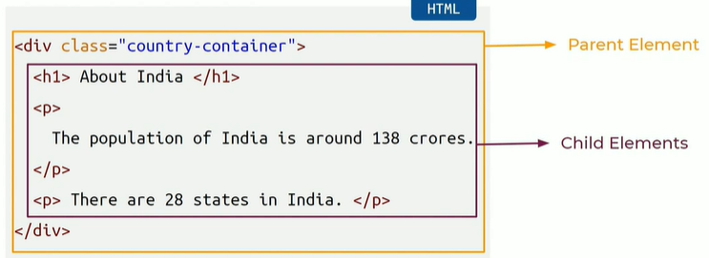
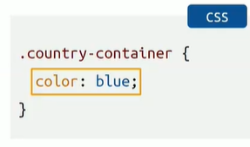
Eg of inheritance
Parent element ki class icham css styles apply cheyadaniki kani heading , paragraph ey element ki ivvaledu
Class selector is used

Slide 33
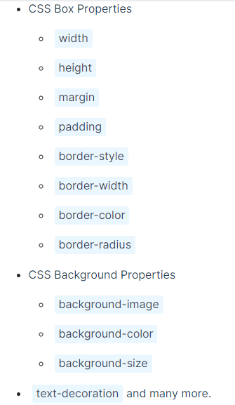
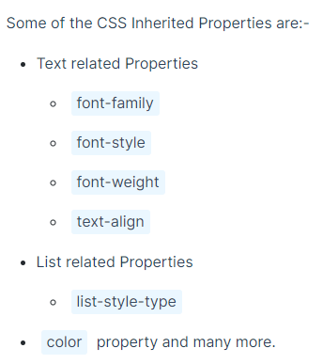
Non-inherited properties

Slide 34
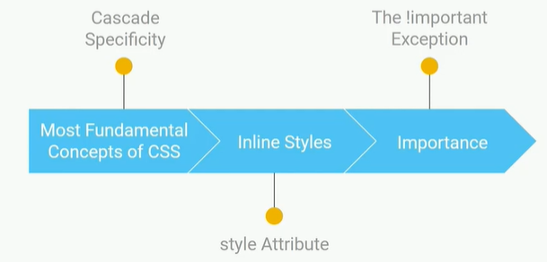
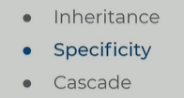

Slide 35
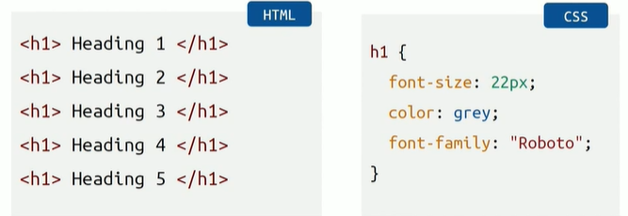
SPECIFICITY
specificty uses tag selector,using class selector & id selector over rides, means they are applicable already use chesina attribute over ride avthundi , inline styles have highest specificty over writes all selectors
More specific is id selector
Compared to id less specific is class selector
Generic selector is tag selector

Slide 36
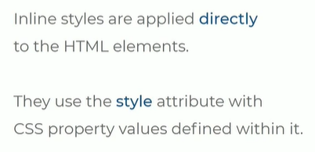
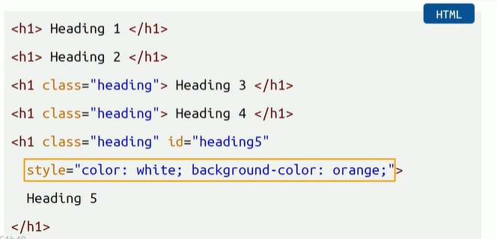
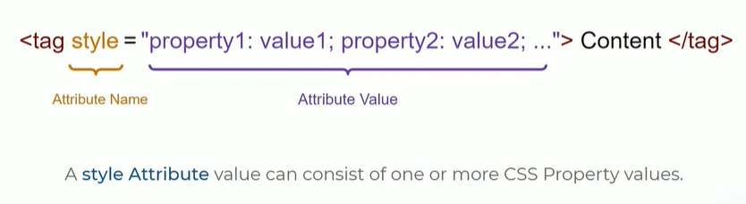
INLINE STYLES

Slide 37
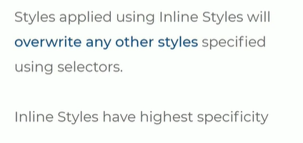
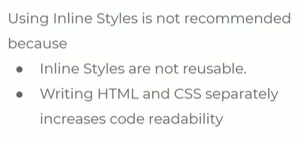

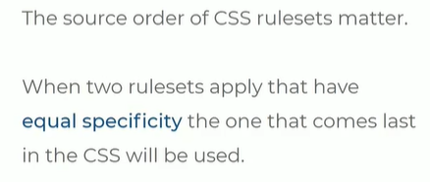
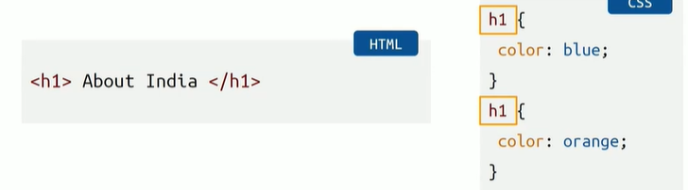

Slide 38

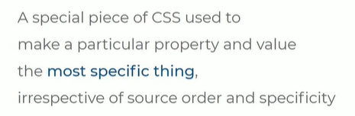
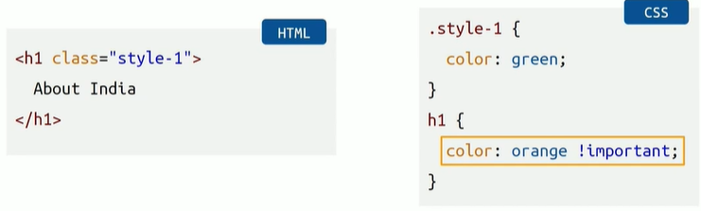
Creating exceptions
Making them more specific
Orange color ivvali ani ardam , nothing can over ride

